Slide 1

Ask us anywhere: roving reference with an iPad
Maryse Laflamme, University of Ottawa Library
maryse.laflamme@uottawa.ca
October 2012
Image : Andrew Dernie (gettyimages.ca)

Slide 2
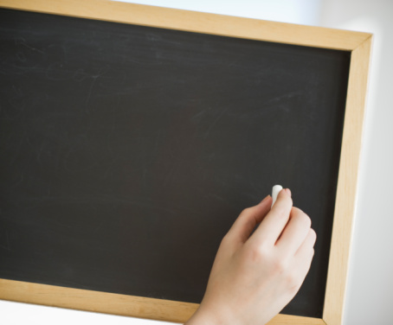
Timeline
First meeting
Results/Comments
Future
Image : Tetra images (gettyimages.ca)

Slide 3
Project timeline
Stephanie Graves ALA, June 2011
First meeting
June 2012
Training week May 2012
First day - roving
September 10, 2012

Slide 4

Why? Where? When? Who? How?
Image : Jorg Greuel (gettyimages.ca)

Slide 5
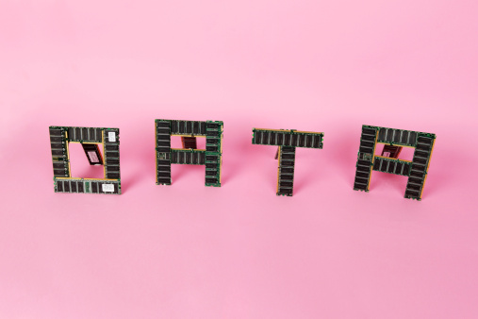
Date | Rover | # of users helped | Location | Language | Duration | Type of question (A, B, C) | Encounter initiated by Rover or User
General information for which an answer is given on the spot without consultation or reference to a source.
Requests which require the consultation of print or automated resources to identify or locate titles.
Requests which require the consultation of print or automated resources to provide an answer.
Image : Richard Newstead (gettyimages.ca)

Slide 6

fun
statistics
location
police
bird nest
visibility
presence
add value
silence
noise
be careful
promotion
Image : Dougal Waters (gettyimages.ca)

Slide 7

Image : Martin Barraud (gettyimages.ca)

Slide 8
Some readings
Lotts, M., & Graves, S. (2011). Using the iPad for reference services: Librarians go mobile. College & Research Libraries News, 72(4), 217-220.
Brown, C. Sulz, D., and Pow, V. (2011, August). Roving reference with iPads: A study of the use of iPads as technological support and service assessment. Paper presented a the annual conference of the International Federation of Library Associations, San Jan, Puerto Rico. Retrievec from http://conference.ifla.org/past/ifla77/197-brown-en.pdf
May, F. (November 23, 2011). Roving reference, iPad-style. Retrieved, May 2, 2012, from http://theidaholibrarian.wordpress.com/2011/11/23/roving-reference-ipad-style/
Gadsby, J & Qian, S. (2012, May) Using an iPad to redefine roving reference service in an academic library. Library Hi Tech News, 29(4), 1-5.

Slide 9
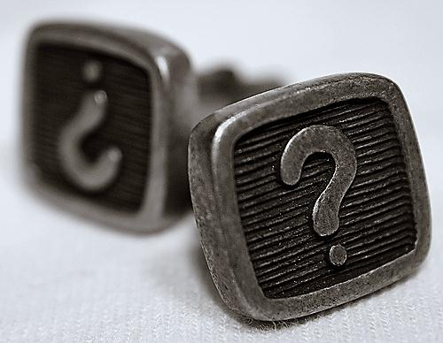
Maryse Laflamme, maryse.laflamme@uottawa.ca

