Slide 1
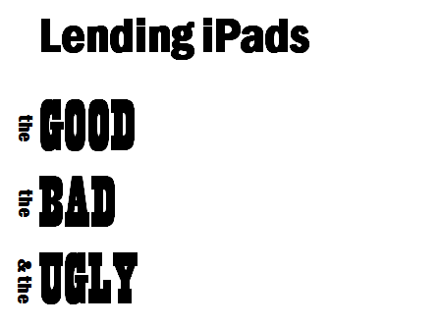
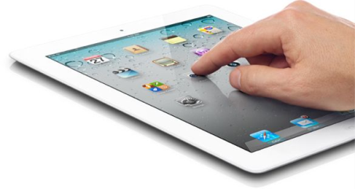


Slide 2

Who owns a tablet or is thinking of buying one in the next six months?
morgueFILE: http://mrg.bz/d9s5g5

Slide 3


Slide 4

rules & regs
uOttawa students & staff
1st-come, 1st-served
2 day loan
overdue fine - $10/hour
replacement fee - $650
details on our website
morgueFILE: http://mrg.bz/qiruOY

Slide 5
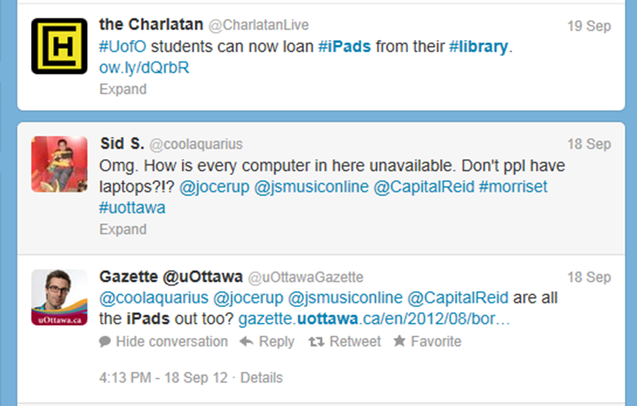

Slide 6
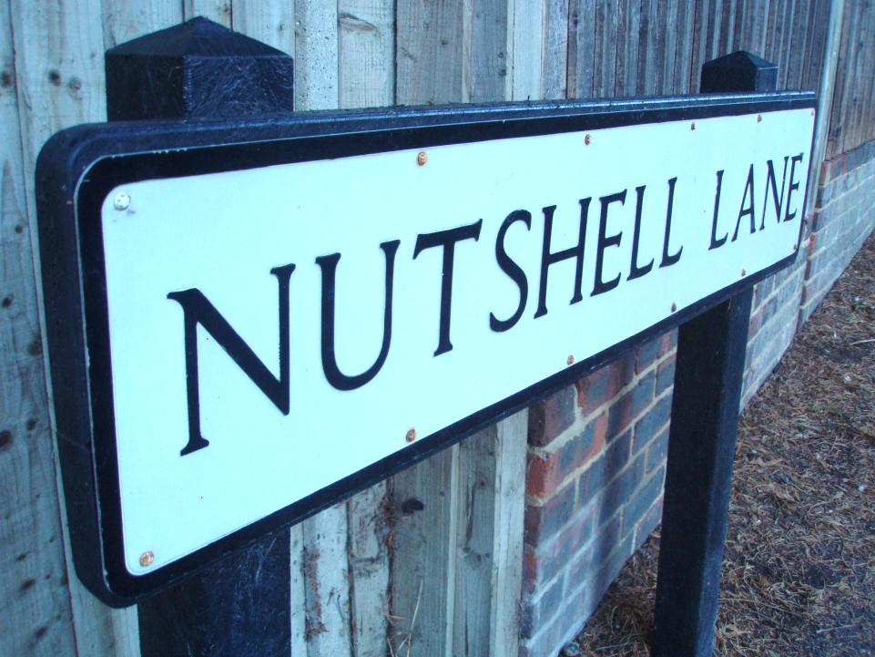
morgueFILE: http://mrg.bz/ndjhrs

Slide 7
a few links
uOttawa Library website: http://www.biblio.uottawa.ca/html/index.jsp?lang=en
Test version of our survey:
http://tinyurl.com/uOttawa-iPad-survey
iPad LibGuide:
http://uottawa.ca.libguides.com/ipad-en
Google Sites Project page:
http://tinyurl.com/uOttawa-iPad-project-site

Slide 8
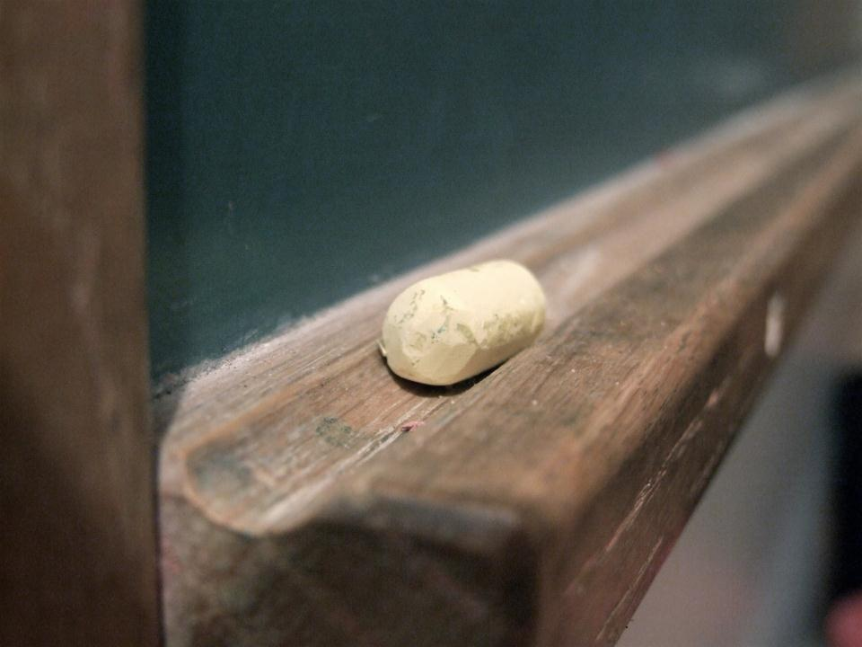
questions?

