Slide 1
Not just for YouTube: Making tablets work for YOU!
Sarah Forbes @4Bes
http://uoft.me/smforbes
OCUL Webinar – October 11, 2012

Slide 2
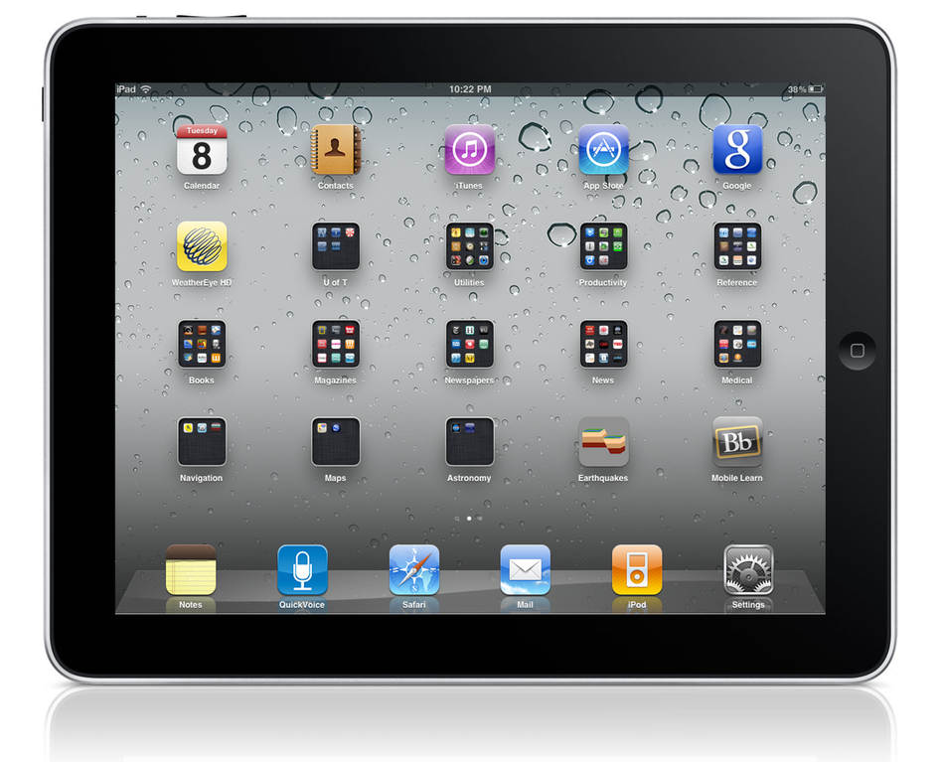
Tablet integration: ground zero

Slide 3
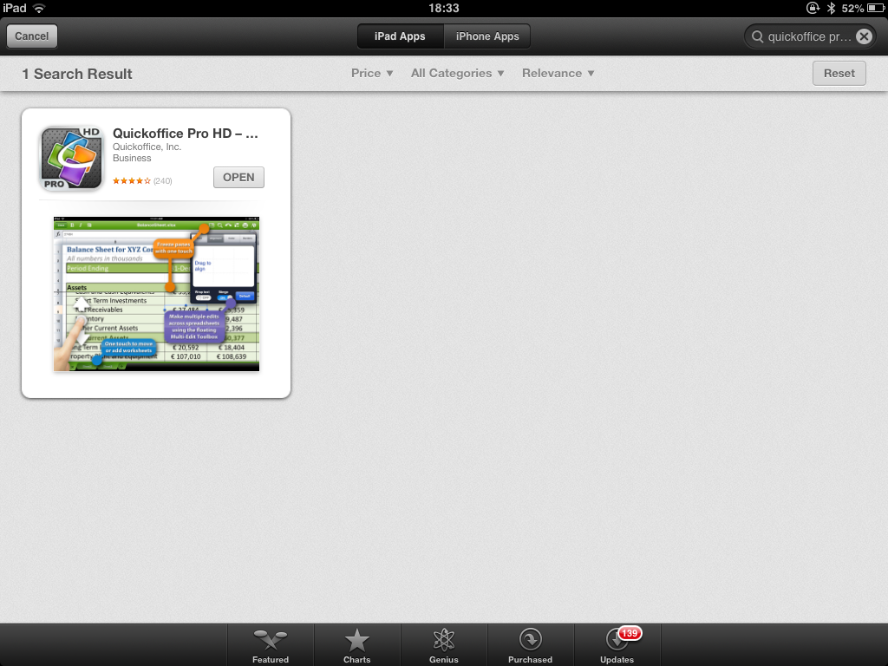
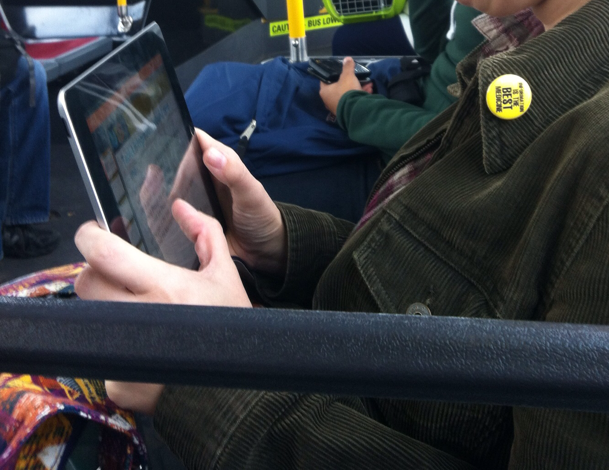
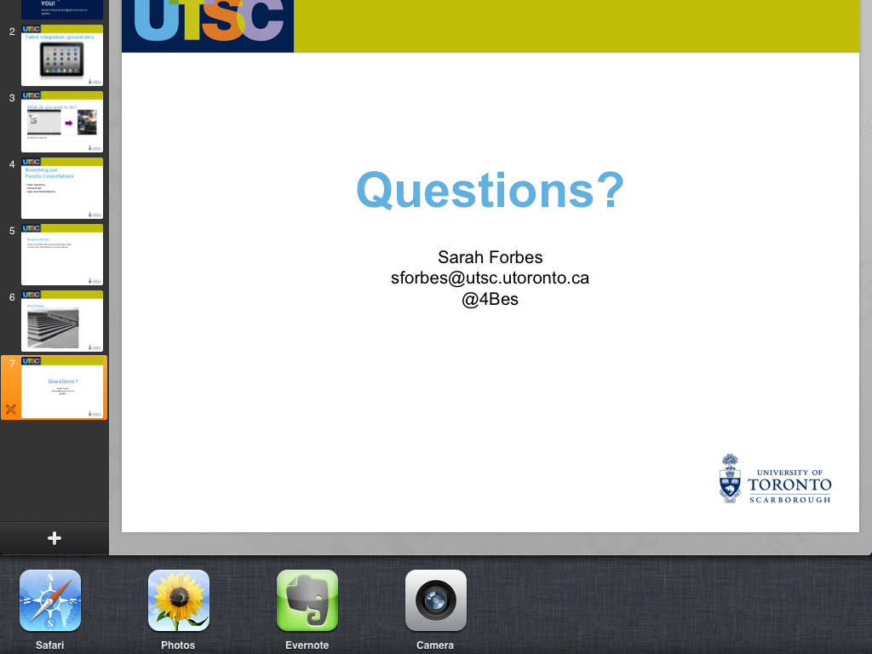
What do I want to do?

Slide 4
Branching out: Consultations
TASK INVENTORY
SHOW & TELL/DEMONSTRATIONS
APP RECOMMENDATIONS
SETUP
TRAINING

Slide 5
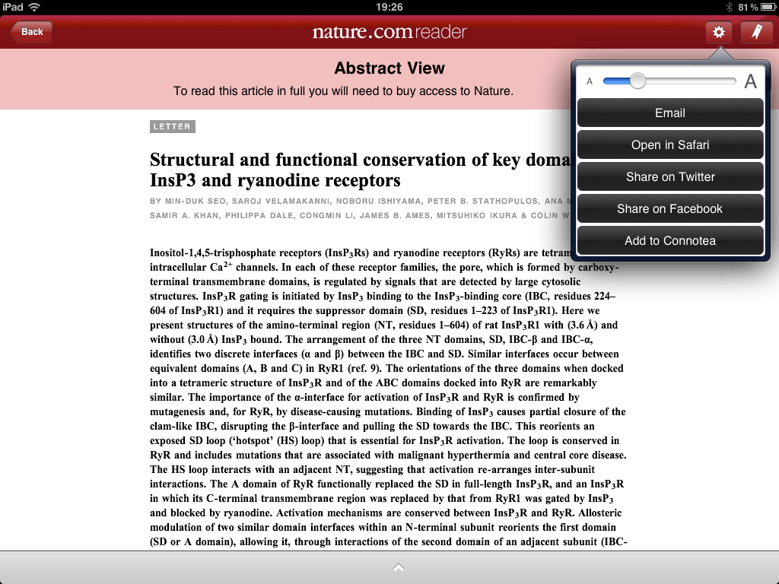
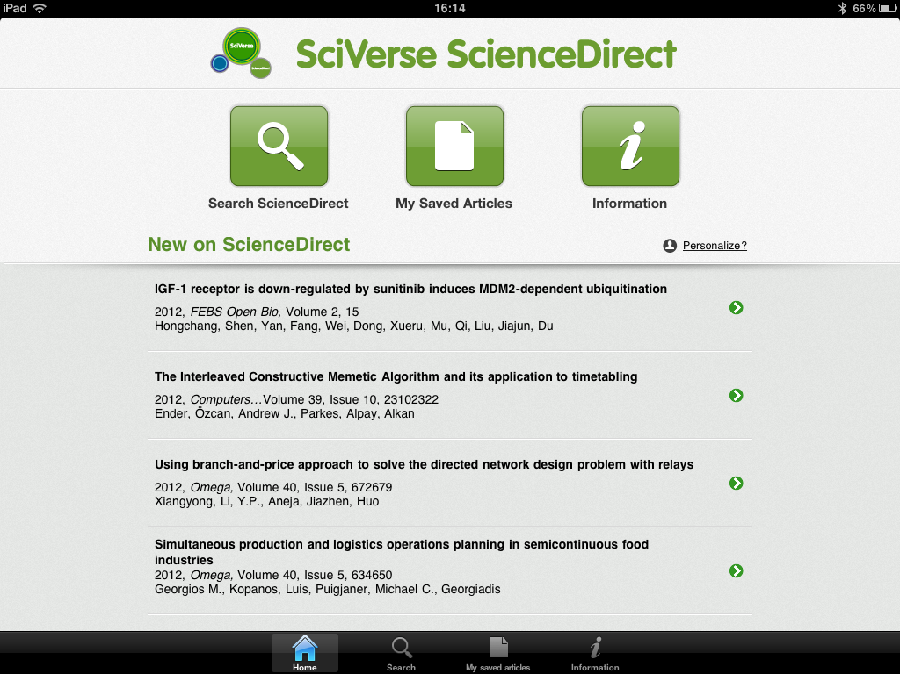
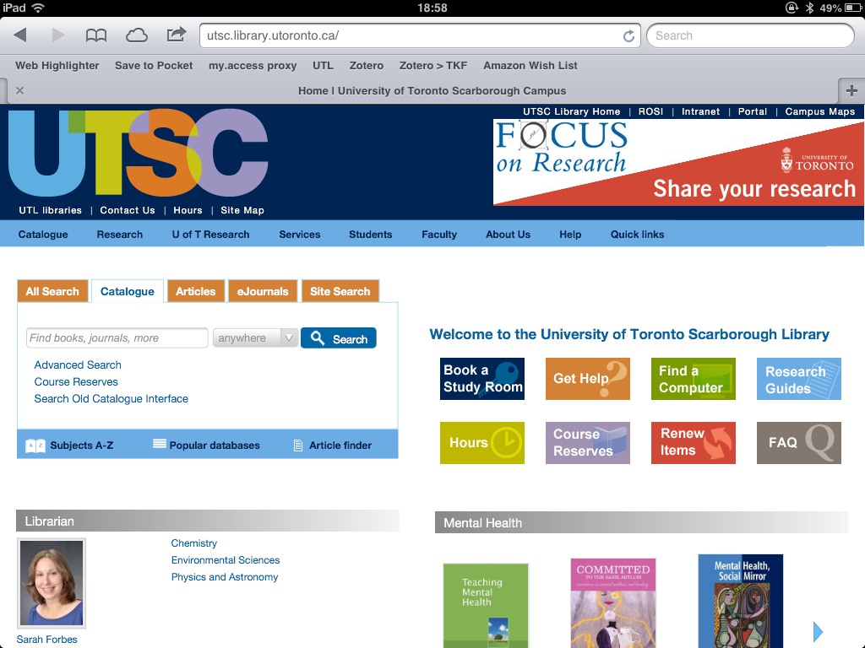
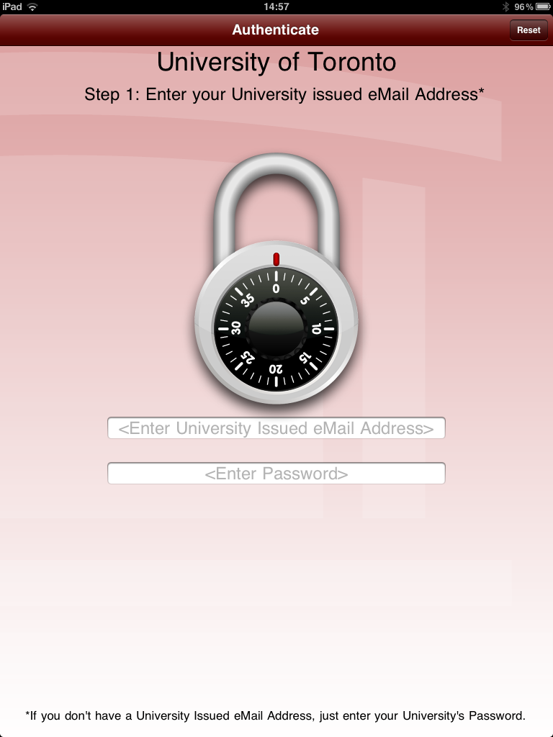
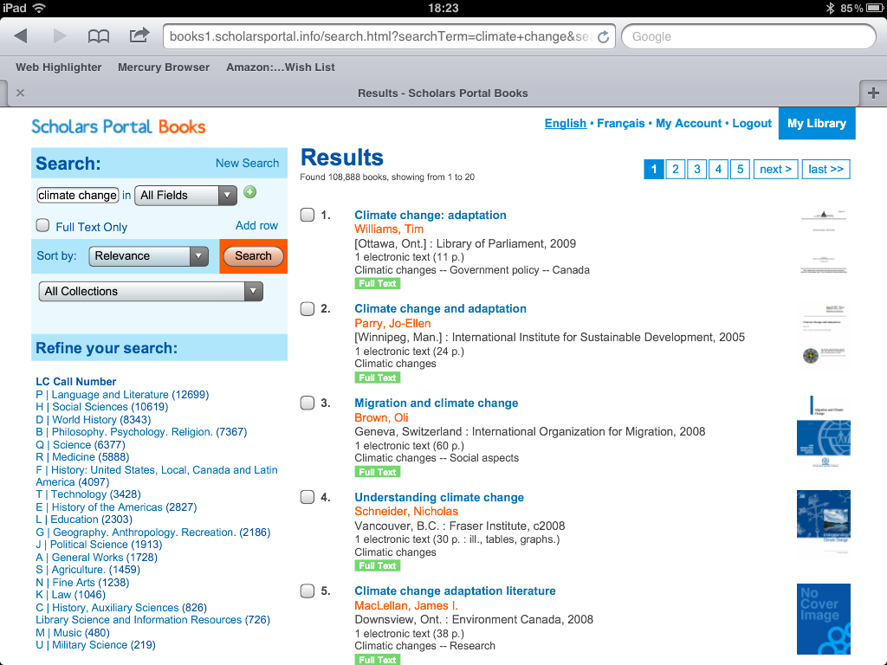
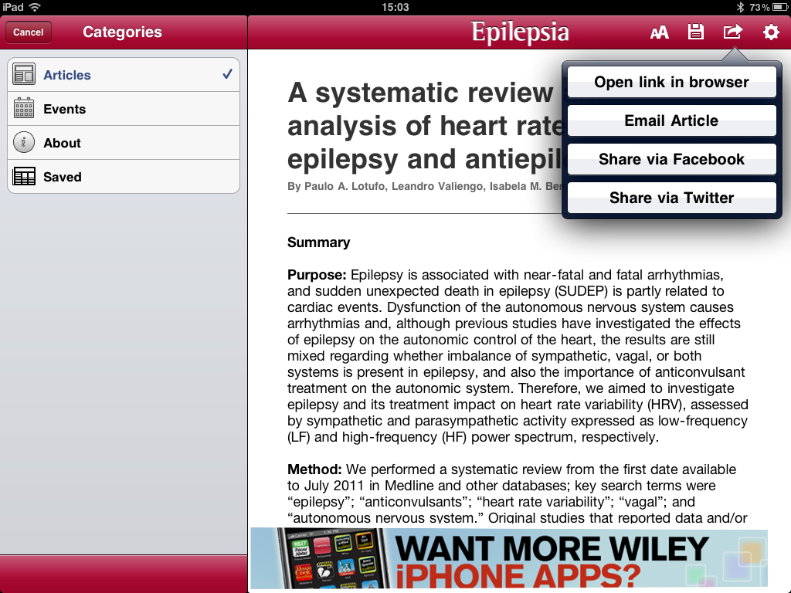
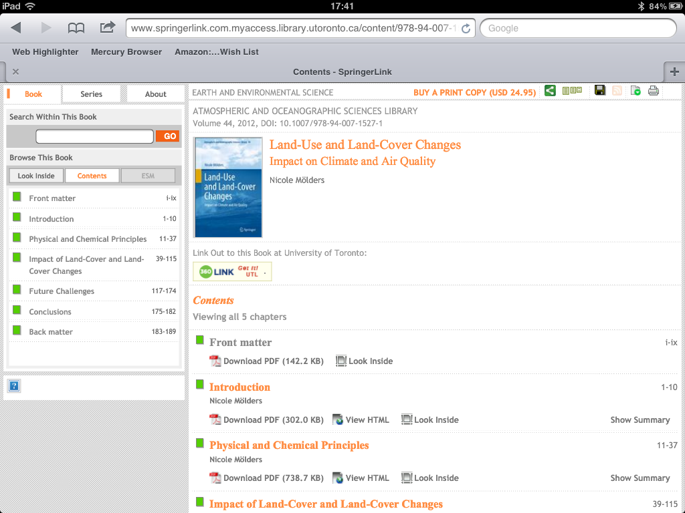
Conducting Research

Slide 6
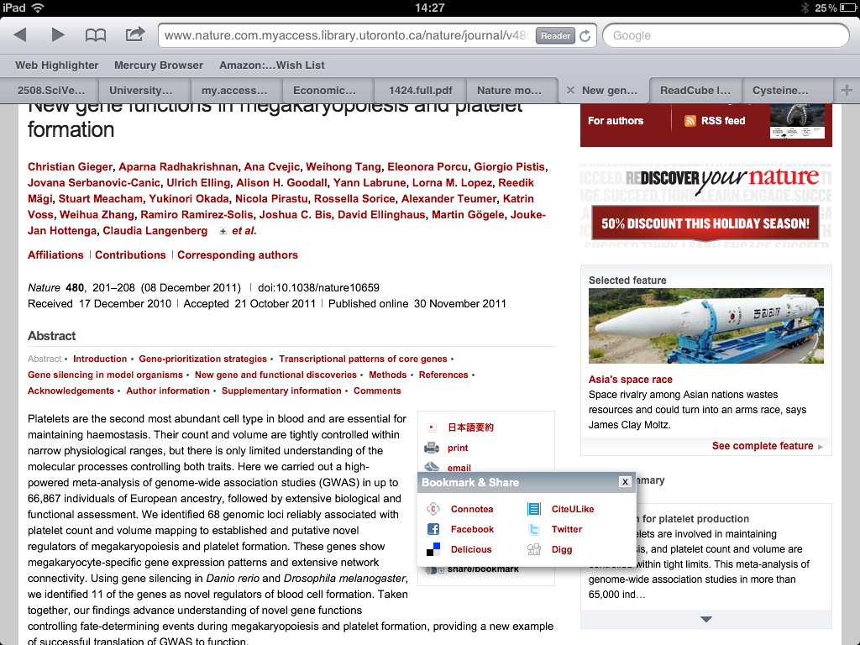
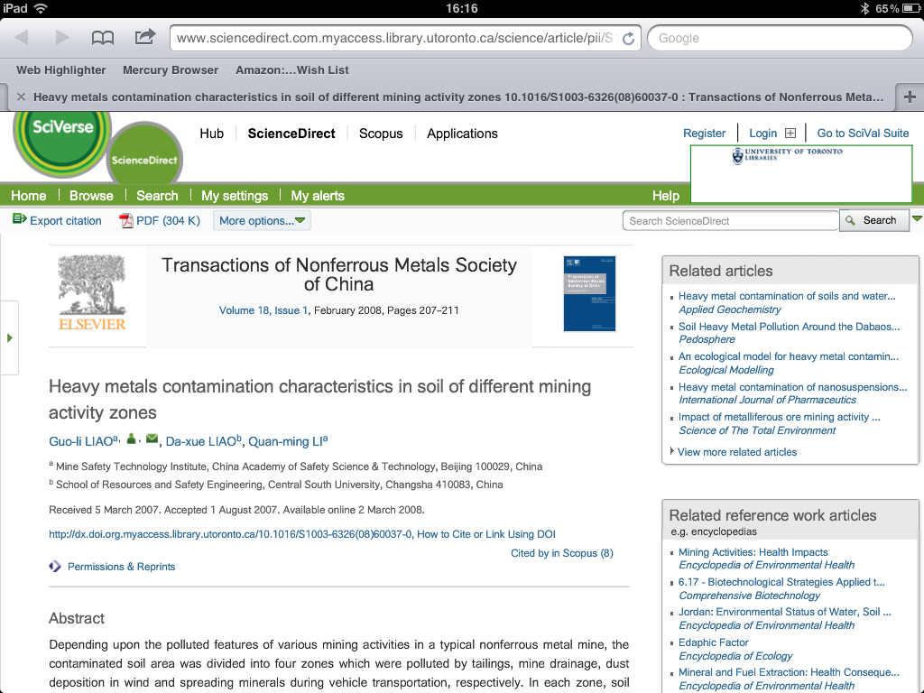

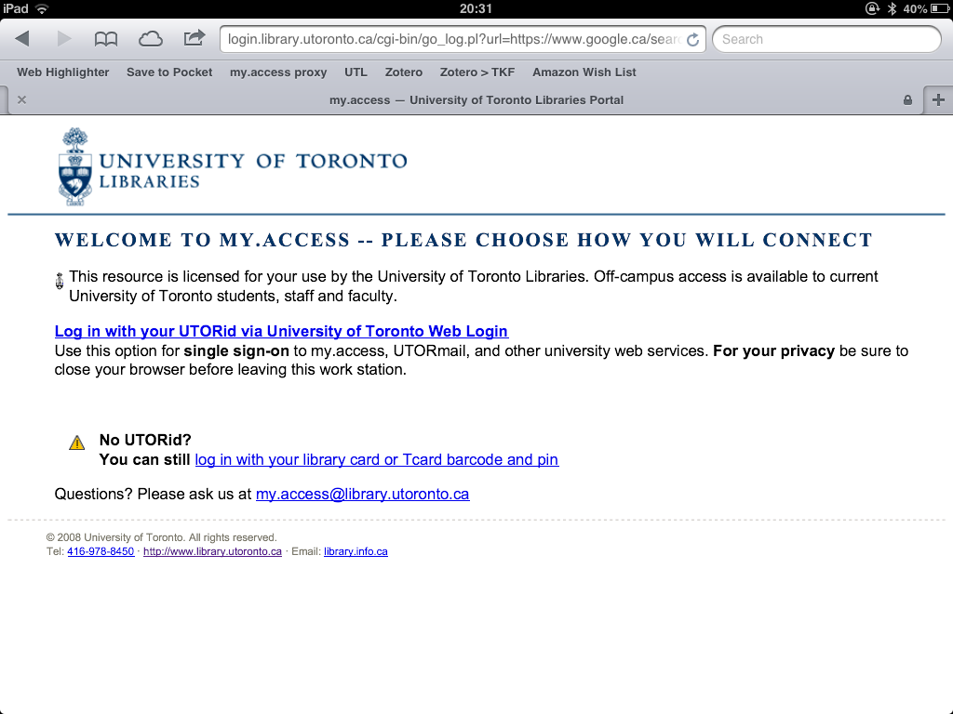
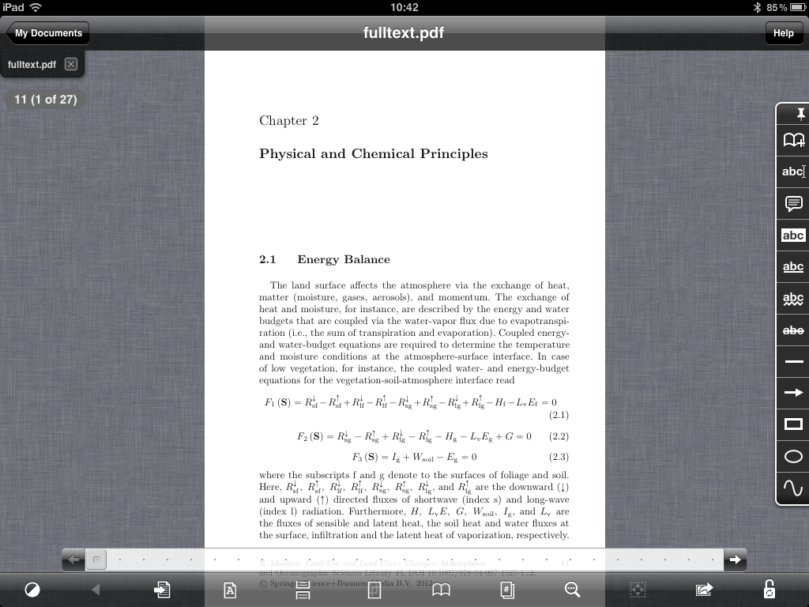
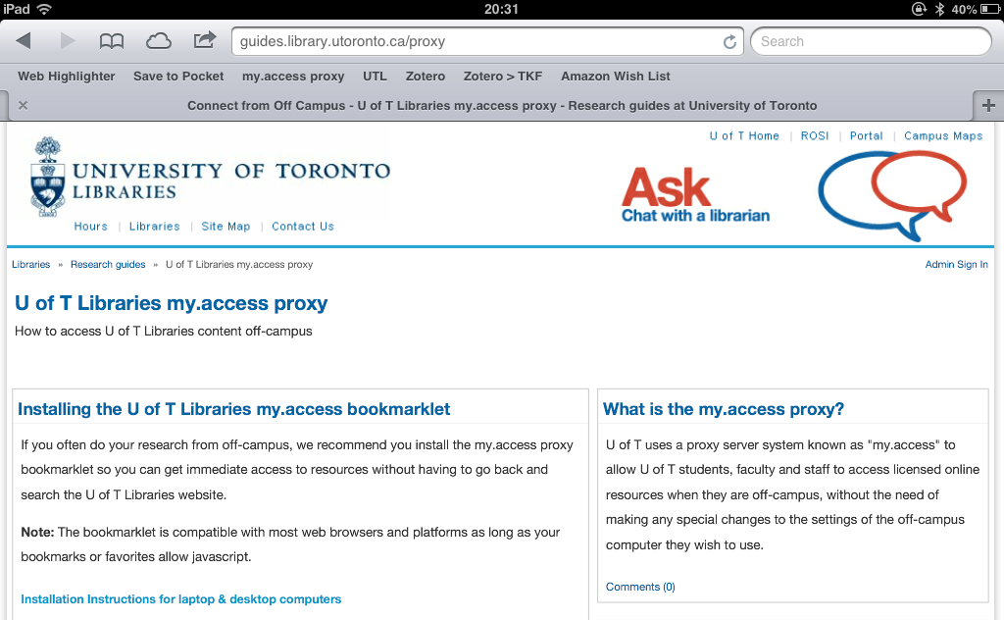

Slide 7
Considerations
DISCOVERY [search options]
ACCESS [full-text, authentication]
READ [online/offline, downloads]
ANNOTATE [highlighting, underlining, notes] & COPY/PASTE
SHARE [via email, social media]

Slide 8
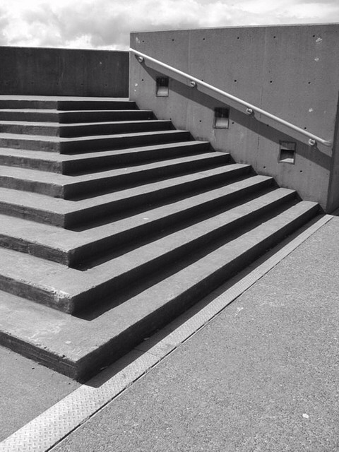
Next Steps
Photo: stairs by Bread Mouth, on Flickr http://flic.kr/p/aqok

Slide 9
Questions?
Sarah Forbes
http://uoft.me/smforbes

